Slide 1
AWS Foundations
AWS Security Fundamentals

Slide 2

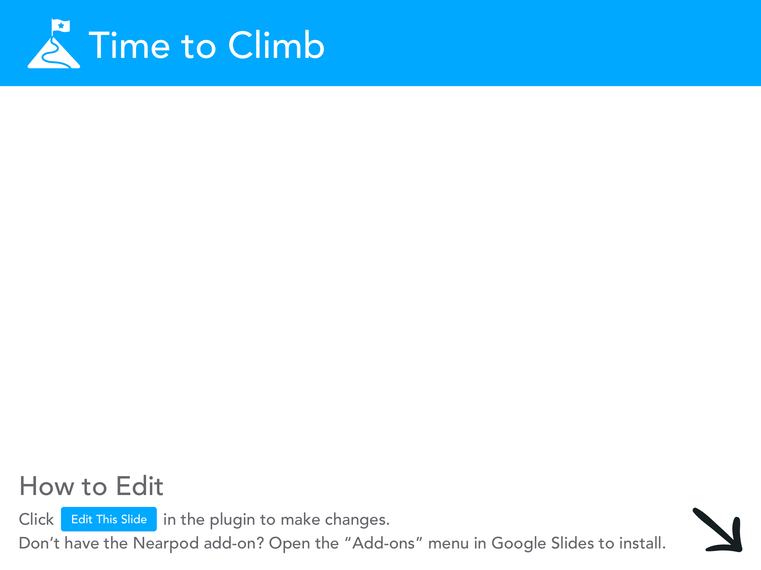

Slide 3
Agenda
Slide 4: Security OF the Cloud
Slide 48: Security IN the cloud
Slide 62: break for 10 min
Slide 83: Detective Controls
Slide 95: Infrastructure Protection
Slide 101: Data Protection
Slide 104: Incident Response
Slide 115: DDos Mitigation
Slide 124: AWS Well-Architected Tool
Slide 126: Lab 4 submission

Slide 4
Introduction to AWS Shared Responsibility Model
The Shared Responsibility Model is a key aspect of cloud security in AWS.
AWS and the customer share responsibilities to achieve total security and compliance.
The division of responsibilities provides a flexible and efficient means to secure the cloud environment.

Slide 5
Security OF the Cloud
Responsibilities of the Cloud Service Provider
Can we see
Your Data Centres?

Slide 6
Security OF the Cloud
NO!
Can we see
Your Data Centres?

Slide 7
Locations - Transparency
Azure and Google Cloud's approach provides a greater level of transparency about the physical location of data centers. Customers and potential customers can use this information when planning their own data management strategies, such as considering data sovereignty and compliance requirements, latency, and redundancy.

Slide 8
Locations - Security through Obscurity
On the other hand, AWS does not publicly disclose the exact locations of its data centers. This could be viewed as a security measure, a practice known as "security through obscurity". By keeping the exact locations undisclosed, AWS may be attempting to reduce the potential for physical attacks on their infrastructure.

Slide 9
Locations - Regional Availability
While AWS does not provide exact locations, they do disclose the regions and availability zones where their services are available. This information can still be useful for customers when planning for latency, redundancy, and data sovereignty.

Slide 10
Locations - Impact on Decision Making
While the transparency of data center locations can be interesting and potentially useful, it's worth noting that for many customers, other factors may be more significant in their choice of cloud provider. These can include the range of services offered, cost, performance, compliance capabilities, and the quality of customer support.

Slide 11
Locations - Audits
Think you need to audit a data center yourself for compliance? Think again. Let's dive into why AWS's security, compliance, and global infrastructure make this a non-issue

Slide 12
Security and Compliance
AWS, along with other major cloud providers, undergoes numerous independent third-party audits regularly. Compliance certifications such as SOC 1, SOC 2, SOC 3, PCI DSS Level 1, and ISO 27001 ensure that data centers meet strict security standards, regardless of their exact location.

Slide 13
Data Sovereignty
Cloud providers like AWS offer customers the option to select geographical regions for their data and services. This helps customers address data residency requirements and keep data within specific legal jurisdictions.

Slide 14
Resiliency and Redundancy
Resiliency in cloud computing is primarily about system design and not about the physical location of data centers.
Redundancy in cloud services is about having them spread out in various geographical regions. This is to ensure that if a catastrophic event were to occur at one location, the services can continue to run uninterrupted using data centers in other regions. The exact physical location of each data center is less important than the overall distribution and the ability to reroute traffic and operations as needed.

Slide 15
Performance
When it comes to performance, proximity to the user is usually more important than the specific location of a data center. This is why cloud providers offer multiple regions and edge locations. The idea is to reduce latency by serving requests from the nearest operational point. The exact address of a data center doesn't really matter as long as it's close enough to provide low-latency service to the end-users.

Slide 16
Why some customers need the exact address?
1. High-Security Government Contracts
2. Insurance Purposes: Sometimes, for insurance reasons, a company may need to provide the exact location where their data is stored. This could be relevant if the company needs to take out a policy to cover potential data loss or business interruption.

Slide 17
Security OF the Cloud
Managing accessing (IAM)
Detective Controls
Infrastructure Protection
Data Protection
Incident Response
DDoS Mitigation

Slide 18
Infrastructure Layer
Backup power equipment
HVAC system
Fire suppression equipment
Telecommunications

Slide 19
Environmental Layer
Flooding
Extreme weather
Seismic activity
To mitigate and prepare for the unexpected, AWS tests their Business Continuity Plan regularly with drills that simulate different scenarios.

Slide 20
Data Layer - customer data
NIST Special Publication 800-88, titled "Guidelines for Media Sanitization"
Clear: This is a software-based method of overwriting the information on the storage media with non-sensitive data. This method should prevent data from being recovered through disk inspection.

Slide 21
Data Layer - customer data
NIST Special Publication 800-88, titled "Guidelines for Media Sanitization"
Purge: This is a method that often involves physical manipulation of the storage media and makes the data inaccessible even through laboratory techniques. Purging might involve degaussing magnetic media or performing a secure erase on solid-state drives.

Slide 22
Data Layer - customer data
NIST Special Publication 800-88, titled "Guidelines for Media Sanitization"
Destroy: This is the most extreme method and involves the physical destruction of the storage media. Destruction techniques can involve disintegration, incineration, pulverization, shredding, or melting. The goal is to render the storage media unusable in the future.

Slide 23

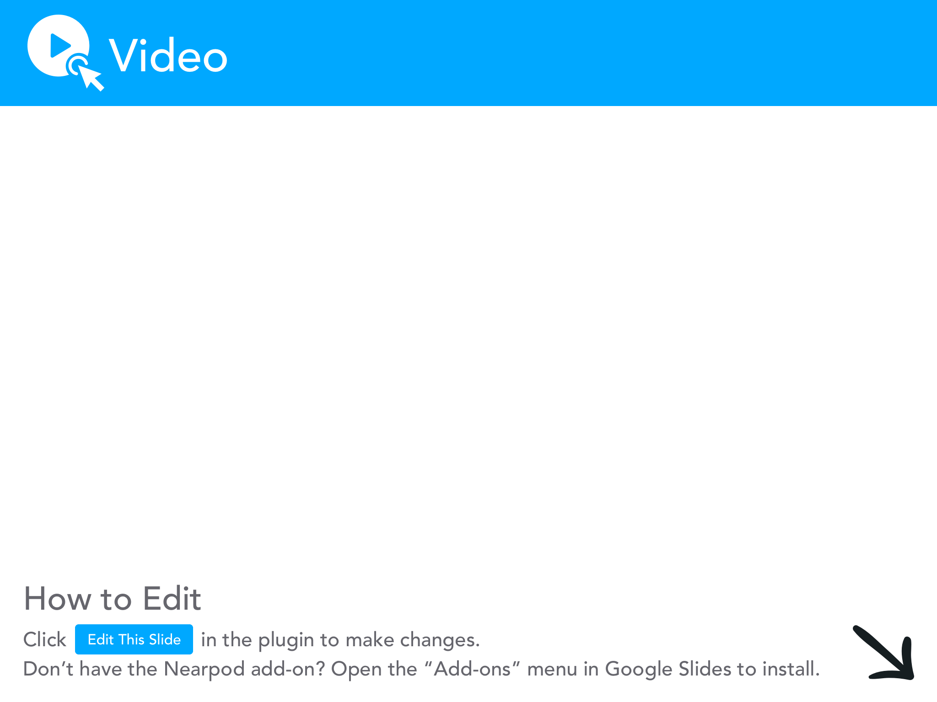

Slide 24
Guidelines for Media Sanitization
Specific method used (clear, purge, or destroy) often depends on the sensitivity of the data, the nature of the media, and the possible risk of exposure.
Note: AWS servers can notify employees of any attempts to remove data. In the unlikely event of a breach, the server is automatically disabled.

Slide 25
Compliance on AWS
Cloud Compliance Definition: Compliance in a cloud context refers to the adherence to legal and regulatory requirements in the design and operation of a cloud infrastructure, services, and workloads. This can encompass a variety of areas including data protection, privacy, and cybersecurity.

Slide 26
Compliance on AWS
Importance of Compliance for Businesses on AWS: Achieving compliance is critical for businesses operating on AWS for several reasons:
1. Trust & Reputation: Demonstrating compliance with recognized standards can build trust with customers and stakeholders, reinforcing your business's reputation.

Slide 27
Compliance on AWS
Importance of Compliance for Businesses on AWS: Achieving compliance is critical for businesses operating on AWS for several reasons:
2. Legal & Regulatory Requirements: Businesses may be legally required to comply with certain standards, especially when handling sensitive information like health records or financial data. Failure to comply can lead to penalties.

Slide 28
Compliance on AWS
Importance of Compliance for Businesses on AWS: Achieving compliance is critical for businesses operating on AWS for several reasons:
3. Risk Mitigation: Compliance frameworks provide guidelines for best practices in IT security, helping businesses protect their data and mitigate the risk of cyber threats.

Slide 29
Transparency through Whitepapers
Informative Reports: Whitepapers are authoritative, in-depth reports on a specific topic, providing a detailed guide or explanation.
Problem Solving: They often address complex issues, helping readers understand an issue, solve a problem, or make a decision.
Expert Knowledge: Whitepapers are typically produced by experts in the field and draw on comprehensive research and knowledge. They often present a company's stance on an issue or provide detailed information about a product or service.

Slide 30
Transparency through Whitepapers
AWS Overview of Security Processes is a whitepaper that largely focuses on the "security OF the cloud".
AWS Infrastructure: This whitepaper explains how the AWS global infrastructure is built and managed for maximum availability, reliability, and security. This includes the design and maintenance of AWS data centers, server infrastructure, and network architecture.

Slide 31
Transparency through Whitepapers
AWS Overview of Security Processes is a whitepaper that largely focuses on the "security OF the cloud".
Data Center Security: AWS discusses the stringent physical security controls in their data centers, including access control, surveillance, and intrusion detection. They also discuss environmental controls like fire suppression and climate control.

Slide 32
Transparency through Whitepapers
AWS Overview of Security Processes is a whitepaper that largely focuses on the "security OF the cloud".
Data Protection: AWS describes their encryption and storage mechanisms for data at rest and in transit. This includes details about the physical security of hardware where customer data is stored.

Slide 33
Transparency through Whitepapers
AWS Overview of Security Processes is a whitepaper that largely focuses on the "security OF the cloud".
Network Security: AWS provides insights into their network architecture, including how they segregate customer data, the use of secure network devices, and DDoS mitigation techniques.

Slide 34
Transparency through Whitepapers
AWS Overview of Security Processes is a whitepaper that largely focuses on the "security OF the cloud".
Incident Response: AWS talks about their incident response team's capability to operate under a formal, well-practiced procedure for managing security events.

Slide 35
What is AWS Artifact (from FAQ)
AWS Artifact, available in the console, is a self-service audit artifact retrieval portal that provides our customers with on-demand access to AWS’ compliance documentation and AWS agreements.
You can use AWS Artifact Reports to download AWS security and compliance documents, such as AWS ISO certifications, Payment Card Industry (PCI), and System and Organization Control (SOC) reports.
You can use AWS Artifact Agreements to review, accept, and track the status of AWS agreements such as the Business Associate Addendum (BAA).

Slide 36
Agreement states (from FAQ)
An Agreement can have two states:
Inactive: An Agreement is in Inactive state if the Agreement has not been accepted by the user or a previously accepted Agreement has been terminated by the user
Active: An Agreement is in Active state if the Agreement has been accepted by the user

Slide 37
What is an audit artifact? (from FAQ)
An audit artifact is a piece of evidence that demonstrates that an organization is following a documented process or meeting a specific requirement. Audit artifacts are gathered and archived throughout the system development life cycle and are to be used as evidence in internal and/or external audits and assessments.
AWS Artifact currently provides customers with reports and agreements that may be used as audit artifacts.

Slide 38
Hypothetical agreements
Business Associate Addendum (BAA): This agreement would apply to customers who are subject to HIPAA regulations. It outlines the responsibilities of both AWS and the customer in handling protected health information (PHI). This might include provisions for how AWS will secure PHI, how it will respond to security incidents, and the customer's responsibilities for using AWS services in a way that complies with HIPAA.

Slide 39
Hypothetical agreements
Online Service Terms: This agreement outlines the terms and conditions of using AWS services. It might include sections on service levels, data privacy, intellectual property rights, termination of services, limitation of liability, and other legal considerations.

Slide 40
Hypothetical agreements
Service Level Agreements (SLAs): This agreement outlines the expected uptime and performance of an AWS service, and what compensation customers can expect if AWS fails to meet these standard.

Slide 41
Let’s use AWS artifact!
We’re going to walk through a purely hypothetical business that needs to comply with HIPAA (Health Insurance Portability and Accountability Act)

Slide 42
Identify Compliance Requirements
Let's say a healthcare company using AWS needs to demonstrate HIPAA (Health Insurance Portability and Accountability Act) compliance to its stakeholders. The first step would be to identify all the compliance requirements associated with HIPAA, including those that are relevant to the cloud services used.

Slide 43
Access AWS Artifact
The company's compliance officer or IT manager would log into the AWS Management Console and navigate to AWS Artifact.

Slide 44
Request Reports
Within AWS Artifact, they could then request access to the AWS HIPAA compliance report. This report provides detailed information on the controls in place at AWS that are relevant to HIPAA.

Slide 45
Review and Implement Controls
The report would be reviewed and the necessary controls and processes would be implemented within the company's applications and environments, as per the shared responsibility model.

Slide 46
Provide Documentation to Auditors
During an audit or when requested by stakeholders, the company could use the compliance report from AWS Artifact as proof of the controls in place at AWS.

Slide 47
Continuous Compliance
As the company continues to use AWS services, they would periodically review and request updated reports via AWS Artifact to ensure ongoing compliance with HIPAA.

Slide 48
Security IN the cloud
Customer Responsibility: This aspect deals with security measures that AWS customers must implement and manage, tied directly to customer data and business requirements.
Customer Data Protection: Includes encryption, network security controls, access control, and managing and securing AWS service configurations.
Security Tools and Services: AWS provides various tools and services like AWS Identity and Access Management (IAM), Amazon Cognito, AWS Key Management Service (KMS), and AWS Shield to help customers maintain security and comply with regulations.

Slide 49
What is an endpoint?
An endpoint is essentially the URL you use to access a service in AWS. For instance, if you have an Amazon S3 bucket named "my-example-bucket" and it's in the US West (Oregon) region, the endpoint to access this bucket would be "my-example-bucket.s3.us-west-2.amazonaws.com". Here, 's3.us-west-2.amazonaws.com' is the default endpoint for S3 in the US West (Oregon) region.

Slide 50
Endpoint: Standard TLS vs FIPS
Some AWS services offer endpoints that support Federal Information Processing Standard (FIPS) 140-2 in some Regions. Unlike standard AWS endpoints, FIPS endpoints use a TLS software library that complies with FIPS 140-2. These endpoints might be required by enterprises that interact with the United States government.

Slide 51
The 11 security requirement areas of FIPS 140-2
Let’s take a peek at what is FIPS 140-2

Slide 52
The 11 security requirement areas of FIPS 140-2
Cryptographic Module Specification: This includes a detailed specification that outlines the cryptographic module, its interfaces, and its operational environment.
Cryptographic Module Ports and Interfaces: The module must clearly define all the physical and logical interfaces and the input, output, control and status information communicated via these interfaces.
Roles, Services, and Authentication: The cryptographic module must support the role of a Crypto Officer (responsible for tasks like installation, configuration, and administration) and User (regular usage). Each role must be authenticated using either role-based or identity-based authentication mechanisms.
Cryptographic officer: An FCKMS role that is responsible for and authorized to initialize and manage all cryptographic services, functions, and keys of the FCKMS. Source: NIST SP 800-152. FCKMS is "Federal Cryptographic Key Management System"

Slide 53
The 11 security requirement areas of FIPS 140-2
Physical Security: For higher levels of FIPS 140-2 (levels 2, 3, and 4), the cryptographic module must have physical security mechanisms to protect it from tampering and unauthorized access.
Operational Environment: The operational environment of the module must be specified and secure. For levels 3 and 4, the module's software and firmware components must be designed to protect against tampering.
Cryptographic Key Management: The module must have secure mechanisms for the management of cryptographic keys, including key generation, entry/output, storage, and zeroization (the act of deleting the key securely when it's no longer required).
Self-Tests: The cryptographic module must perform a series of self-tests to ensure it's working correctly when it's initialized (on power-up) and during its operation.

Slide 54
Hypothetical levels to FIPS 140-2
Level 1: A basic web server uses a FIPS 140-2 Level 1 compliant software library for TLS. It provides secure connections, but does not have any specific physical security measures.
Level 2: A VPN server may use a FIPS 140-2 Level 2 compliant software library for TLS. This level includes role-based authentication, ensuring that only authorized administrators can configure the security settings.

Slide 55
Hypothetical levels to FIPS 140-2
Level 3: A financial institution's servers might use a FIPS 140-2 Level 3 compliant software library for TLS. It includes measures to protect cryptographic keys and other sensitive data. If an unauthorized attempt is made to access this data, the system is designed to delete it.
Level 4: A military system could use a FIPS 140-2 Level 4 compliant software library for TLS. It includes mechanisms to protect against physical attacks and environmental conditions, such as high radiation or extreme temperatures.

Slide 56
AWS CloudHSM and FIPS 140-2 Compliance
AWS CloudHSM: This is a cloud-based hardware security module (HSM) that allows users to generate and manage their own encryption keys in the AWS Cloud. The hardware security modules used by CloudHSM meet the FIPS 140-2 Level 3 requirements.
Key Management and Cryptographic Operations: When users operate services like AWS CloudHSM or AWS Key Management Service (KMS), they can be confident that their cryptographic operations and key management are handled in a manner that aligns with FIPS 140-2 standards.
Secure Transmission with FIPS Endpoints: AWS ensures that the software TLS implementation protecting data transmitted to and from FIPS endpoints is FIPS 140-2 compliant, thus adding another layer of security to data in transit.

Slide 57
Hardware Security Module
Handles cryptographic operations (including those used by TLS). The HSM itself could be designed to meet FIPS 140-2 Level 4, which means it would have physical tamper-resistance and even tamper-evidence features.
This could involve seals or locks that reveal when tampering has occurred, or even extreme measures such as zeroizing (automatically erasing) cryptographic keys stored within the HSM if it detects a tamper event.

Slide 58
Azure and AWS: Everything is an API and Uses IAM
In both Azure and AWS, every service can be interacted with via an API, and access to these API calls is managed through IAM.
Operations such as creating a virtual machine, configuring a database, or setting up a network, are essentially API calls.

Slide 59
Role-Based Access Control in Azure and AWS
Azure organizes access control around the concept of Role-Based Access Control (RBAC) with three elements: security principal (user or group), role assignment, and scope.
AWS uses IAM roles and policies for granting access, similarly organized around users, permissions, and resources.
Despite specific implementation details and terminology differences, both platforms share a similar approach to access management.

Slide 60
The IAM Superheroes
Captain Admin: As the AWS account root user, Captain Admin has complete access to all AWS services and resources in the account. They are responsible for managing users, granting necessary permissions, and ensuring overall security of the account. However, in practice, Captain Admin's power is wielded sparingly, and most tasks are carried out by IAM users with more limited permissions.
Elastic Enforcer: They manage the team's Amazon EC2 instances. With IAM policies that grant them full access to EC2, they can launch, terminate, and configure instances, set up Auto Scaling and load balancing, and secure instances using Security Groups and Network ACLs. However, they can't read S3 buckets or manage DynamoDB tables, keeping the principle of least privilege intact.

Slide 61
The IAM Superheroes
Storage Saver: With full access to Amazon S3 via IAM, Storage Saver manages the team's data storage. They create and configure buckets, manage object lifecycle, ensure data backup, and secure data with bucket policies and ACLs. Their power is confined to S3 service only, maintaining segregation of duties.
Dynamo Defender: As a specialist in Amazon DynamoDB, Dynamo Defender creates and manages NoSQL databases for the team. They are responsible for data modeling, capacity planning, and ensuring data security with encryption and fine-grained access control. Dynamo Defender doesn't have access to EC2 or S3, limiting their scope of influence to DynamoDB.

Slide 62

Take a break!
Go take 10 min. Fresh air, brain food, or a coffee.

Slide 63
Types of AWS Credentials
Username & Password
MFA device using a single-use code
User Access Keys
Amazon EC2 Key pairs

Slide 64
Types of AWS Credentials
User Access Keys for Programmatic Calls: AWS users require user access keys to make programmatic calls to AWS services, whether using the AWS CLI, AWS SDKs, or direct HTTPS API calls. These access keys, used to digitally sign API requests, ensure the secure transmission of data.
Structure and Usage of User Access Keys: Each user access key credential consists of an access key ID and a secret key. Users can have up to two active access keys, providing flexibility for key rotation or permission revocation, thus enhancing overall security.

Slide 65
Types of AWS Credentials
Key Pair for EC2 Connections: AWS utilizes a public-key infrastructure to authenticate SSH or RDP connections to EC2 instances. This requires the creation or usage of a key pair, with the private key being used to establish the connection.
Key Pair Generation and Import Options: AWS allows users to either generate a new key pair within the EC2 service or import their own set of keys, providing flexibility in security management.
Limitations and Recommendations: EC2 key pairs do not offer user accountability, making them less suitable for regular use. For daily access to instances, AWS suggests integration with a directory domain (Active Directory or LDAP) to facilitate federated access and track user-instance interactions.

Slide 66
AWS Secrets Manager
Manage Secrets: AWS Secrets Manager helps protect access to applications, services, and IT resources without upfront investment or ongoing maintenance costs. This enables you to easily rotate, manage, and retrieve database credentials, API keys, and other secrets throughout their lifecycle.
Automated Protection: Secrets Manager can automate the process of rotating secrets for Amazon RDS, Amazon DocumentDB, and Amazon Redshift, helping enhance your applications' resilience against potential database compromises.

Slide 67
AWS Secrets Manager
Let's consider an example where you have an application running on an Amazon EC2 instance, which needs to access a MySQL database hosted on Amazon RDS. The database requires a username and password for access.
Normally, you might hard code these credentials into your application or store them in a configuration file, both of which can pose security risks. If the credentials were exposed in any way, an attacker could potentially gain access to your sensitive data.

Slide 68
AWS Secrets Manager
With AWS Secrets Manager, you can avoid these risks by safely storing your database credentials (the 'secret'). Here's how it works:
Creating the Secret: Instead of embedding the database credentials in your application, you store them in Secrets Manager. During the creation of the secret, you specify the database connection details including the username and password.
Accessing the Secret: Your application is then modified to retrieve these credentials from Secrets Manager using an SDK or CLI, which would make an API call to Secrets Manager. The application would authenticate to Secrets Manager using its own IAM role that you've set up, which gives it permission to access the secret.

Slide 69
AWS Secrets Manager
Rotating the Secret: One of the key features of Secrets Manager is its ability to automatically rotate secrets without disrupting your applications. You can configure Secrets Manager to rotate the secret (i.e., change the password) for the database automatically every N days. When the rotation happens, Secrets Manager updates the secret in its storage with the new password. Since your application retrieves the database credentials from Secrets Manager every time it establishes a connection, it always gets the most recent password.
This way, your sensitive data (like database passwords) are not embedded in the application. They are safely stored and automatically managed, reducing the risk of accidental exposure.

Slide 70
AWS IAM Access Analyzer
Analyze Resource Policies: AWS IAM Access Analyzer helps you identify resources in your organization and accounts, such as Amazon S3 buckets or IAM roles, that are shared with an external entity.
Identify Public and Cross-Account Access: It continuously monitors public and cross-account sharing policies to provide detailed auditing and governance of access to your AWS environment.

Slide 71
AWS Security Token Service (STS)
Temporary, Limited-Privilege Credentials: AWS STS is a service that enables you to request temporary, limited-privilege credentials for AWS Identity and Access Management (IAM) users or for users that you authenticate (federated users).
Flexible Identity Federation: STS supports identity federation, allowing users who already have passwords elsewhere (in a corporate directory, for instance) to get temporary access to AWS services.

Slide 72
AWS Directory Service
Directory Provision and Setup: AWS Directory Service allows you to set up and run Microsoft Active Directory (AD) on AWS, or connect your AWS resources with an existing on-premises Microsoft Active Directory.
Supports AWS Applications and Services: AWS Directory Service enables your directory-aware workloads and AWS resources to use managed Active Directory in the AWS Cloud.

Slide 73
AWS Organizations
Centralized Control: AWS Organizations enables you to centrally manage and govern your AWS environment as you grow and scale your AWS resources.
Policy-Based Management: You can use service control policies (SCPs) to set fine-grained permissions and control access to services across multiple AWS accounts.

Slide 74
AWS Organizations and Azure Subscriptions
Account Structure: AWS Organizations allows for creating multiple accounts under one master account for extra layers of resource isolation. Azure Subscriptions, which are similar to individual AWS accounts, act as a boundary for managing resources tied to a single Azure account.
Centralized Control: AWS Organizations offers Service Control Policies (SCPs) that provide central control over maximum available permissions for all accounts in your organization. In Azure, this level of governance across multiple subscriptions is achieved using Management Groups.
Use Cases: Both AWS Organizations and Azure Subscriptions (in conjunction with Management Groups) provide mechanisms for segregating, organizing, and governing resources based on business needs, while offering centralized control and management.

Slide 75
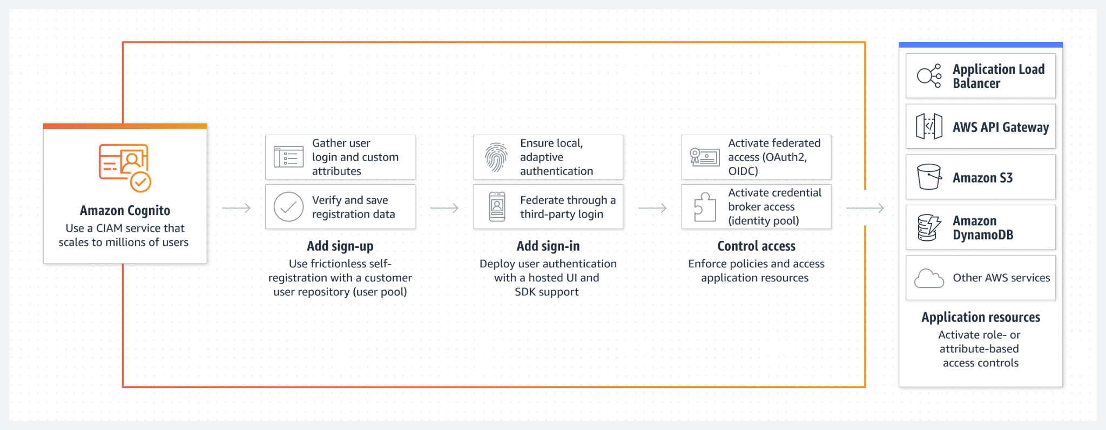
Amazon Cognito

Slide 76
Introduction to Amazon Cognito
User Identity: Amazon Cognito manages user identities in your web and mobile apps. It helps handle user registration, login, and access control, reducing the necessity to manage backend infrastructure for these functionalities.
Social and Enterprise Identity Providers: Amazon Cognito supports sign-in with social identity providers like Google, Facebook, and Amazon, as well as enterprise identity providers via SAML 2.0.
Security: Cognito provides robust security features, such as multi-factor authentication (MFA) and encryption of user data, for safeguarding user credentials and data.

Slide 77
Key Features of Amazon Cognito
User Pools: Cognito User Pools provide a secure user directory that scales to hundreds of millions of users. They are an easy way to add sign-up and sign-in functionality to your app.
Federation: Cognito Identity Pools (federated identities) enable you to create unique identities for your users and federate them with identity providers, allowing you to maintain a consistent user identity across different applications.
Synchronization: Cognito syncs user profile data across mobile devices and web applications, ensuring that a user's app experience remains consistent, irrespective of the device they are using.

Slide 78
Amazon Cognito example
Let's say you're developing a mobile fitness application that provides personalized workout routines and nutrition plans for users. The app needs to allow users to create accounts, log in, and maintain personalized settings and data across multiple devices. Furthermore, you want users to be able to log in using their existing Google or Facebook accounts for a seamless experience.
With Amazon Cognito, you can implement all of this efficiently:

Slide 79
Amazon Cognito example
User Registration & Sign-In: Using Amazon Cognito User Pools, you can quickly set up a secure user directory to manage the sign-up and sign-in processes. This would include email/phone number verification and an adaptive authentication system to protect against unauthorised access.
Social Sign-In: Amazon Cognito's federated identities feature allows you to integrate the app with identity providers like Google and Facebook. This way, users can easily sign in using their existing accounts from these platforms.

Slide 80
Amazon Cognito example
Data Synchronization: Amazon Cognito Sync would handle the synchronization of the user's data - such as workout progress or custom settings - across their devices. This ensures that users have a consistent app experience, whether they're accessing it from their smartphone, tablet, or the web application.
So, instead of managing the complex infrastructure and coding required for these functionalities, Amazon Cognito lets you focus on developing the actual fitness program and user interface of your application.

Slide 81
Amazon S3 Server-Side Encryption (SSE)
Unique Key per Object: Every file (object) stored in S3 is encrypted with a unique key. This means even if one object's key was somehow compromised, it wouldn't affect other objects.
Master Key: To add another layer of security, the unique key used to encrypt the object is itself encrypted with a master key. The master key is managed by AWS and is rotated regularly.
Double-Envelope Encryption: This method of using a unique key for the object, which is then encrypted with a master key, is known as double-envelope encryption

Slide 82
Accessing Encrypted Objects and Data in Transit
Simple Access: When you need to access your data, a simple GET request is all that's needed. AWS S3 handles the decryption process for you.
Decryption: S3 decrypts the master key and then uses the decrypted unique key to decrypt the object, making the data available for you.
Data in Transit: Data in transit is secured using HTTPS (TLS), which is the same secure method used across the internet for secure communications. This means your data is protected when it's sent over the network to or from Amazon S3.

Slide 83
AWS CloudTrail – Event History
API Activity Recording: CloudTrail keeps track of every API call made in your AWS environment. This includes identity of the caller, the time of the call, the source IP address of the caller, the request parameters, and the response elements returned by the AWS service.
Access Insights: The event history allows you to view, filter, and download recent AWS account activity. This helps in identifying patterns and spotting unusual activity.
Resource Lifecycles: CloudTrail records creation, modification, and deletion of AWS resources. It's helpful for audits, security analysis, and operational troubleshooting.

Slide 84
AWS CloudTrail – Log File Integrity Validation
Integrity Checking: AWS CloudTrail provides a mechanism to verify the integrity of the log files. This ensures the data has not been tampered with, providing a reliable source of information for security audits.
Log File Encryption: All CloudTrail log files stored in your S3 bucket are encrypted by Amazon S3 server-side encryption (SSE) for protection in transit and at rest.
Digest Files: For every log file written to your S3 bucket, CloudTrail writes a corresponding digest file to a different S3 bucket. These digest files can be used to demonstrate log file integrity, ensuring that the data has not been modified, deleted, or lost since CloudTrail delivered it.

Slide 85
No pretty charts or graphs
AWS CloudTrail itself does not provide a graphical user interface (GUI) with charts and graphs for visualizing log data. Its main function is to record API calls and deliver log files for your AWS account activity.
However, CloudTrail logs can be integrated with other AWS services that do provide visualization tools:
Amazon CloudWatch: This service can be used to aggregate, monitor, and visualize CloudTrail logs. You can create CloudWatch dashboards that include various widgets, like graphs and charts, to display CloudTrail log data.

Slide 86
No pretty charts or graphs
AWS Management Console: While not specifically a visualization tool, the Management Console does allow you to view, search, and download recent events in your CloudTrail event history.
Amazon QuickSight: This is a business intelligence tool from AWS that can be used to visualize data from various sources, including CloudTrail logs. It allows you to create and publish interactive dashboards that include Machine Learning insights.
Third-Party Tools: There are also many third-party log analysis and visualization tools (like Loggly, Splunk, etc.) that can ingest and visualize CloudTrail logs.

Slide 87
Amazon CloudWatch
Monitoring Service: Amazon CloudWatch is a monitoring and observability service that provides data and actionable insights for AWS, hybrid, and on-premises applications and infrastructure.
Data Collection: It collects raw data from AWS resources such as EC2 instances, DynamoDB tables, and RDS DB instances in real-time.
Alerts and Alarms: With CloudWatch, you can create alarms and notifications for specific triggers, letting you proactively respond to any changes in your AWS environment.

Slide 88
Advanced Features of Amazon CloudWatch
Logs and Metrics: It enables deep, searchable, and actionable insights from logs and metrics using automated machine learning algorithms.
Dashboards: CloudWatch provides unified, customizable dashboards to manage and troubleshoot applications and infrastructure.
Event Driven Automation: It can respond to system-wide performance changes and automate operational tasks by triggering AWS Lambda functions based on pre-set rules or schedules.

Slide 89
Lambda function in CloudWatch
Auto-Scaling: You could use a Lambda function to automatically adjust the number of EC2 instances in your application based on the load. For instance, if a CloudWatch alarm is triggered due to high CPU utilization across your EC2 instances, a Lambda function could be invoked to increase the number of instances and distribute the load.
Automated Backups: Lambda functions can be used to create automated backups of your databases in response to a CloudWatch event. For example, you can schedule a CloudWatch event to trigger a Lambda function that creates a snapshot of your Amazon RDS databases every night.

Slide 90
Lambda function in CloudWatch
Error Notifications: If your application throws an error and that error is logged to CloudWatch, you could have a Lambda function that is triggered on the appearance of that error in the log. This function could then send a notification to your development team or even create a ticket in your incident management system.
Resource Cleanup: If you have EC2 instances or other resources that are underutilized, you can set CloudWatch alarms for low usage. When these alarms are triggered, a Lambda function can be invoked to stop or terminate these instances, helping you save costs.

Slide 91
Even more Detective Controls
In your lab 4 there is also: GuardDuty, Trusted Advisor, VPC Flow Logs, Security Hub.

Slide 92
Overview of AWS Config
Assessment and Audit Tool: AWS Config enables assessment, audit, and evaluation of AWS resource configurations.
Continuous Monitoring: It continuously monitors and records AWS resource configurations, and allows automated evaluation of these configurations.
Configuration and Compliance Review: AWS Config lets you review changes, understand detailed resource configuration histories, and evaluate compliance against internal guidelines.

Slide 93
Key Features of AWS Config
Resource Inventory: AWS Config discovers and records the current configurations of resources within your account and tracks changes to these configurations.
Change Management: AWS Config streams real-time change events to Amazon CloudWatch Events. This data can be used to update CMDBs, ITSM tools, SIEM tools, or initiate action through AWS Step Functions or AWS Lambda.
Compliance Tracking: AWS Config provides a detailed view of AWS resource configuration, how resources relate to each other, and their past configurations, aiding in tracking compliance over time.

Slide 94
AWS Config example
Monitoring Security Groups: AWS Config allows for continuous monitoring of changes made to your security groups, which serve as virtual firewalls for your EC2 instances.
Change Detection and Recording: If a change is detected, AWS Config records the detailed information of the change, including the identity of the individual who made the change, the time of the change, and the specific alterations made.
Importance for Security and Compliance: This capability is crucial for maintaining security, enabling compliance auditing, and providing valuable information for troubleshooting purposes.

Slide 95
Virtual Private Cloud (VPC)
VPC is a customizable, isolated virtual network in the AWS Cloud consisting of:
Subnets: A subnet is a range of IP addresses in your VPC. You can launch AWS resources into a subnet that you select. You can have public subnets (which have route to the internet) and private subnets (which do not have route to the internet).
Route tables: A route table contains a set of rules, called routes, that are used to determine where network traffic is directed. Each subnet in your VPC must be associated with a route table; the table controls the traffic for the subnet.
Internet Gateways: An internet gateway is a horizontally scalable, redundant, and highly available VPC component that allows communication between instances in your VPC and the internet.

Slide 96
Virtual Private Cloud (VPC)
Network Access Control Lists (NACLs): A stateless network access control list (ACL) is an optional layer of security for your VPC that acts as a firewall for controlling traffic in and out of one or more subnets.
Security Groups: A stateful security group acts as a virtual firewall for your instance to control inbound and outbound traffic.

Slide 97
Stateful vs Stateless Rules
Stateful Rule Example (AWS Security Groups): When you browse a website, your computer (let's say at port 4444) makes an outbound request to the web server (port 80). The stateful firewall rule remembers this connection. When the web server (port 80) sends the requested data back to your computer (port 4444), the firewall knows that this is a response to an earlier request and allows it in.
Stateless Rule Example (AWS NACLs): Using the same web browsing scenario, the stateless firewall sees the outbound request from your computer (port 4444) to the web server (port 80) and allows it. However, when the web server (port 80) tries to send data back to your computer (port 4444), the firewall doesn't remember the previous request. Unless there's an explicit rule to allow inbound traffic from port 80 to port 4444, the firewall will drop the packet.
Key Takeaway: In a stateful rule (like AWS Security Groups), return traffic from established connections is automatically allowed. In a stateless rule (like AWS NACLs), return traffic must be explicitly allowed by the rules. This affects how you design your security strategy in AWS.

Slide 98
AWS Automation and Inventory
Review Slide of everything covered so far
Automation: AWS provides tools and services to safely automate common and repetitive IT operations and management tasks across AWS resources. This ensures efficient management and reduces the chances of errors.
Inventory: With AWS, you can collect detailed information about your instances and the software installed on them. This aids in understanding system configurations, installed applications, network configurations, updates, and other system properties. It helps you to maintain a comprehensive inventory of your AWS resources.
Efficiency and Compliance: By automating tasks and maintaining an up-to-date inventory, you can significantly increase operational efficiency and ensure compliance with policies and regulations.

Slide 99
AWS Patch Manager, Parameter Store, Run Command, and Session Manager
Review Slide of everything covered so far
Patch Manager: AWS Patch Manager lets you deploy software patches automatically across large groups of Amazon EC2 or on-premises instances. This keeps your systems up-to-date and secure.
Parameter Store: AWS Parameter Store is a centralized store for managing your configuration data, such as database strings or secrets like passwords. It separates your secrets and configuration data from your code, enhancing security.
Run Command & Session Manager: AWS Run Command lets you manage instances remotely at scale without logging into your servers. AWS Session Manager allows for management of Windows and Linux EC2 instances via a browser-based interactive shell or CLI, without the need to open inbound ports, manage SSH keys, or use bastion hosts. These tools provide a simple way of automating common administrative tasks across groups of instances.

Slide 100
Amazon Inspector
Network Assessments: Amazon Inspector can perform network reachability assessments to identify potential network accessibility issues in your AWS environment. For example, it can identify overly permissive security groups that might allow unwanted inbound traffic to reach your EC2 instances.
Host Assessments: On the host level, Amazon Inspector checks for vulnerabilities or deviations from best practices in the underlying OS and systems. This includes checking for outdated or vulnerable software packages installed on the EC2 instances.
Behavioral Analysis: Amazon Inspector can also perform behavioral analysis of the applications running on your EC2 instances to identify potential security issues or unusual behavior.

Slide 101
AWS Key Management Service (KMS)
Ease of Use: AWS KMS is integrated with other AWS services making it easier to encrypt data stored in these services and control access to the keys that decrypt it.
Scalability: AWS KMS is designed to scale seamlessly and handle demanding workloads of any size.
Access Control: It provides fine-grained access control over who can use keys using AWS Identity and Access Management (IAM) policies.
Audit Trail: AWS KMS logs all usage of your keys to AWS CloudTrail, allowing you to meet regulatory and compliance needs.
Cost: AWS KMS is more cost-effective and requires less management overhead compared to AWS CloudHSM.

Slide 102
AWS CloudHSM
Hardware Control: AWS CloudHSM provides secure cryptographic key storage by making dedicated, single-tenant Hardware Security Module (HSM) instances available to you within your own Amazon Virtual Private Cloud (VPC).
Regulatory Compliance: AWS CloudHSM is designed to meet stringent regulatory requirements for cryptographic operations and key storage by providing a highly secure, physical tamper-resistant environment.
Flexibility: AWS CloudHSM allows you to generate, store, import, export, and manage your cryptographic keys, including symmetric keys and asymmetric key pairs.
Access Control: In AWS CloudHSM, access to keys is controlled solely by the customer. AWS does not have access to keys stored in a CloudHSM instance.
Cost: AWS CloudHSM is more expensive than AWS KMS due to the dedicated hardware and increased control it offers.

Slide 103
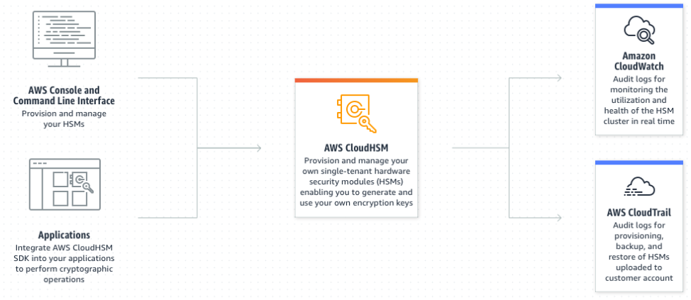
AWS CloudHSM
https://aws.amazon.com/cloudhsm/

Slide 104
AWS CloudFormation
AWS CloudFormation is a service that allows you to manage, configure, and provision your AWS resources.
It uses a declarative programming model, meaning you specify what resources you need, and CloudFormation handles the 'how'.
Now, let's explore why using CloudFormation can be a game-changer for managing AWS resources on the next slide.

Slide 105
AWS CloudFormation - infrastructure as code
Repeatability: CloudFormation templates can be version-controlled and reused, enabling you to create duplicate environments quickly and reliably. This is particularly useful for creating development, test, and production environments that are identical.
Scalability: As your infrastructure grows, managing it manually becomes increasingly difficult. CloudFormation allows you to manage large infrastructures as code, making it easier to understand, version, and modify.
Consistency and Reduced Errors: Manual processes are error-prone. With CloudFormation, you define your infrastructure as code, reducing the likelihood of manual errors. Once a template is tested and confirmed to be working as expected, it can be reused without worrying about manual mistakes.
Supplemental information - may skip slide

Slide 106
AWS CloudFormation - infrastructure as code
Automation: CloudFormation templates can be used in automation pipelines. For example, you could use a continuous integration/continuous deployment (CI/CD) pipeline to automatically launch stacks based on your CloudFormation templates whenever there's a change to your application code.
Resource Dependencies: CloudFormation understands the dependencies between resources and can automatically create or delete resources in the correct order. For example, if an EC2 instance is dependent on a particular security group, CloudFormation ensures that the security group is created before the EC2 instance.
Integration with other AWS Services: CloudFormation works seamlessly with other AWS services. For instance, it integrates with AWS Identity and Access Management (IAM) to control who can create, update, and delete stacks.
Supplemental information - may skip slide

Slide 107
AWS Step Functions in Incident Response
Orchestration of services: AWS Step Functions coordinates the sequence of operations in an incident response scenario, ensuring that each step is executed in the correct order.
Automation of response actions: Step Functions initiates workflows that automate crucial response actions, such as removing and isolating compromised instances, creating snapshots of volumes, and notifying the team.
Creation of secure analysis environment: Using AWS CloudFormation templates, Step Functions helps create a new, isolated environment for secure, in-depth analysis of the compromised instance.
Directing investigation and reporting: The workflow directs the forensics instance to perform investigations and generate reports, which are sent to the team via Amazon SNS.
Amazon Simple Notification Service (SNS): send push notifications, SMS, and email messages to multiple subscribers

Slide 108
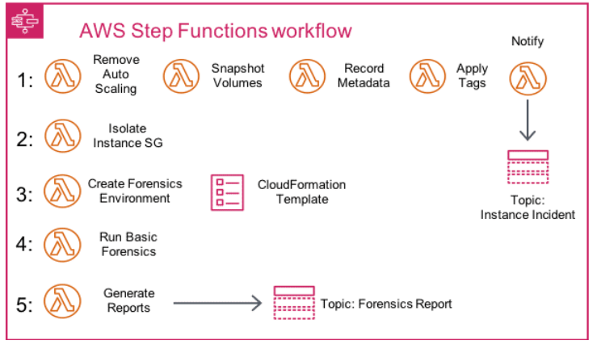
We had an incident!
Source: Amazon

Slide 109
Step 0 (before step 1)
Identifying the compromised instance: When a script or third-party tool identifies a compromised instance, it pushes the instance ID to an Amazon SNS topic. A Lambda function verifies these IDs and, if the instance is indeed compromised, initiates a Step Functions workflow.

Slide 110
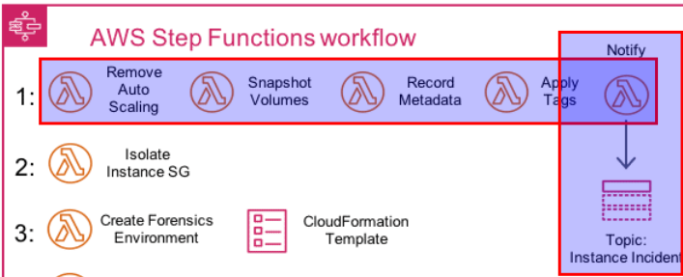
Step 1 Initial Response
The compromised instance is removed from its auto scaling group, an EBS volume snapshot is taken, instance metadata is recorded, a quarantine resource tag is applied, and the team is notified.

Slide 111
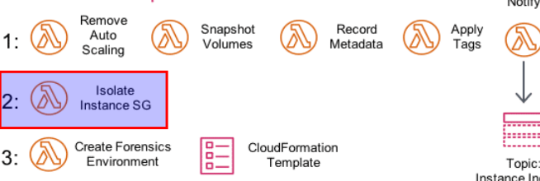
Step 2 Isolation
The instance is isolated by removing all previously associated security groups. A new forensics security group with no ingress or egress permissions is assigned.

Slide 112
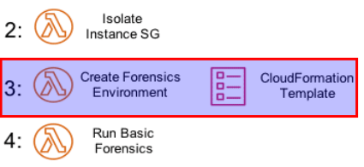
Step 3 Environment Creation “Operating in a Clean Room”
AWS CloudFormation creates a new environment, including a new VPC with a forensics instance and prebuilt tools attached to a copy of volumes from the snapshots.

Slide 113
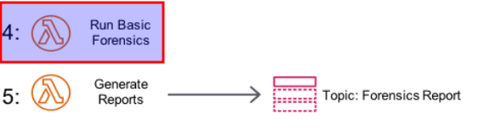
Step 4 Investigation
A basic forensics investigation is performed on the attached volumes.

Slide 114
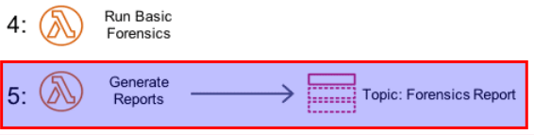
Step 5 Reporting
Reports are generated with the investigation results and sent to the team via Amazon SNS.

Slide 115
Denial Of Service (DoS)
Could be also distributed to make DDoS
Application (Layer 7)
Transport (Layer 4)
Network (Layer 3)
We’ll look at the layers of an onion to protect assets through defence in depth.

Slide 116
Network & Transport layer
Protection against Layer 3 & 4 Attacks: AWS Shield Standard and Advanced provide protection against DDoS attacks at the network and transport layers (layer 3 and 4). These layers are susceptible to network volumetric and network protocol attacks. Network volumetric attacks attempt to saturate the capacity of the targeted network or resource, denying service to legitimate users. Network protocol attacks, such as TCP SYN floods, abuse a protocol to deny service to the targeted resource and can also be volumetric in nature, intending to saturate the network capacity while exhausting the state of the targeted resource or intermediate resources​¹​.

Slide 117
Network & Transport layer
Detection and Mitigation: AWS Shield is designed to detect a wide range of known DDoS attack vectors and zero-day attack vectors. The mitigation process covers threats even if they are not explicitly known to the service at the time of detection. This means that AWS Shield can provide protection against unforeseen and novel threats, enhancing the overall security of your AWS resources​²​.

Slide 118
Network & Transport layer
DNS Routing Policies: Amazon Route 53 supports a variety of DNS routing policies like Simple Routing, Failover Routing, Geolocation Routing, Geo Proximity Routing, and Latency-Based Routing. These policies can help distribute traffic across multiple resources, potentially in multiple regions, making the service more resistant to DDoS attacks. By effectively distributing incoming requests, a single resource or region is less likely to become overwhelmed by a sudden influx of traffic typical in a DDoS attack.

Slide 119
Application Layer
AWS WAF (Web Application Firewall) is designed to protect against a variety of DDoS (Distributed Denial of Service) attacks at the application layer (Layer 7), including:
SQL Injection Attacks: AWS WAF can identify and block SQL injection attempts. These attacks involve the insertion of malicious SQL code via user input fields to manipulate or exploit the database behind the application. AWS WAF uses customizable web security rules to identify and block these attacks.
Cross-Site Scripting (XSS) Attacks: AWS WAF can also protect against XSS attacks, where attackers inject malicious scripts into web pages viewed by other users. These scripts can lead to user data theft or other malicious activities.
HTTP Flood Attacks: This is a type of DDoS attack where the attacker floods the server with HTTP requests with the intent to overwhelm the server. AWS WAF can mitigate these attacks by allowing you to write rules to identify patterns of these flood attacks and take action.

Slide 120
Understanding WAF Protection in an Encrypted World
Scenario: We know that AWS WAF (Web Application Firewall) can protect against various Layer 7 (application layer) attacks such as SQL Injection, Cross-Site Scripting (XSS), and HTTP Flood attacks.
Question: But, how can a WAF protect against these application level attacks when all our traffic is encrypted?
Hint: Think about where and when the decryption of the data occurs in the lifecycle of a request-response.

Slide 121
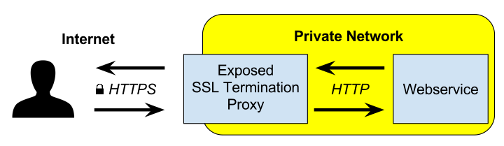
TLS termination
TLS termination (also known as SSL offloading) occurs when an incoming client connection that is secured by the Transport Layer Security (TLS) protocol is decrypted at the load balancer and passed on to the backend servers as plain text. The process of encryption and decryption can consume significant processing power, especially with high volumes of traffic. By handling this at the load balancer level, the backend servers are freed up to handle other processing tasks, improving the overall performance of the application. Image: Wikipedia

Slide 122
TLS termination
1) The client makes a secure connection to the load balancer, rather than to the server directly.
2) The load balancer decrypts the incoming request and determines which server to route the request to based on its load balancing algorithm.
3) The load balancer sends the request to the selected server. This can be done over a secure (TLS) connection for end-to-end encryption, or over an unencrypted connection, depending on the specific requirements of the application.
4) The server processes the request and sends the response back to the load balancer, which then encrypts the response and sends it back to the client.

Slide 123
Web Application Firewall in action
1. The client makes a secure connection to the load balancer, rather than to the server directly.
2. The load balancer decrypts the incoming request. If AWS WAF is integrated with the load balancer, the decrypted request can be inspected by AWS WAF at this stage. AWS WAF applies its rulesets to identify and block any suspicious or malicious traffic.
3. If the request is allowed by AWS WAF, the load balancer determines which server to route the request to based on its load balancing algorithm.
4. The load balancer sends the request to the selected server. This can be done over a secure (TLS) connection for end-to-end encryption, or over an unencrypted connection, depending on the specific requirements of the application.
5. The server processes the request and sends the response back to the load balancer.
6. The load balancer then encrypts the response and sends it back to the client.

Slide 124
AWS Well-Architected Tool
Definition: The AWS Well-Architected Tool is a self-service tool designed to help customers review the state and efficiency of their AWS workloads at any time, without the need for an AWS Solutions Architect.
Purpose: The tool aims to provide a consistent review process to understand potential risks in workload architectures and to identify steps for improvement.
Key Features:
Assesses workloads across six pillars of the Well-Architected Framework: Operational Excellence, Security, Reliability, Performance Efficiency, and Cost Optimization.
Provides actionable improvement plan based on the assessment.
Note: The tool is free of charge. Users only pay for AWS resources consumed during the process.

Slide 125
AWS Well-Architected Tool example
Step 1: Define your workload: Describe the AWS resources and architecture that make up your application or service.
Step 2: Answer the questions: The tool provides a set of questions across the six pillars of the Well Architected Framework. Your answers will help the tool understand your workload's current state.
Step 3: Get your improvement plan: Based on your answers, the AWS Well-Architected Tool will provide a plan describing potential improvements that can be applied to your workload.

Slide 126
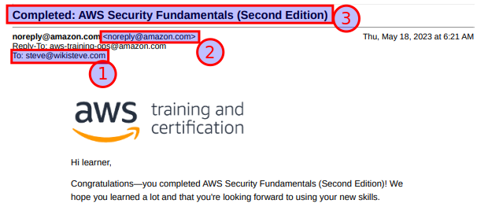
Lab 4 submission

